Slide 1


Airbnb Price Prediction
Group 4
Trieu Vo & Alok Shrivastava
ALY 6020: Predictive Analytics

Slide 2


Table of Contents
Introduction
Explanation of the data
Methodology
Data Analysis
Models Building & Evaluation
Conclusion

Slide 3



1. Introduction
As more people choose Airbnb as their primary accommodation provider, Airbnb has effectively challenged the traditional hotel business. Since its establishment in 2008, Airbnb has experienced tremendous development, with the number of rentals listed on its website increasing at an exponential rate each year.
We use the Inside Airbnb dataset to identify significant trends in customer interest and predict the price of rentals in the US and Europe using Machine Learning models. This problem is similar to a classical use case of machine learning: house price prediction. We can then provide solutions to business difficulties.
Make Money
When Hosting
Save Money
When traveling
Share Culture
Local Connection To The City

Slide 4


2. Explanation of the Data
instant_bookable
last_review
latitude
longitude
maximum_nights
minimum_nights
name
neighbourhood
number_of_reviews
price
property_type
review_scores_rating
reviews_per_month
room_type
Trieu Vo
accommodates
amenities
availability_365
bedrooms
beds
calculated_host_listings_count
host_has_profile_pic
host_id
host_identity_verified
host_name
host_response_rate
host_response_time
id
200,000 Europe listings
27 features
Alok Shrivastava
200,000 United States listings
27 features

Slide 5






3. Methodology
Data Collection & Import
Data Cleaning
Data Manipulation
Collect data from the website…
Remove / Fill missing values…
Convert categorical features to numerical features…
Data Visualization
Data Reduction
Modeling & Evaluation
Visualize features in the dataset…
Remove unnecessary features…
Linear Regression, Decision Tree, Random Forest, XGBoost

Slide 6
TRIEU VO

Slide 7
4.1. Data Collection
Trieu:
Use “Link Grabber” Chrome extension to get the listing links from the source of Inside Airbnb.
Use Regular Expression technique and Sublime Text to separate them into US listing links and Europe listing links.
Download 2 datasets. Each datasets contains over 200,000 listings.
Trieu gets the Europe dataset and Alok gets the US dataset.

Slide 8
4.2. Data Import
Trieu:
Import necessary libraries: janitor, dplyr, skimr, tidyr, zoo, tidyverse, dataPreparation, effects, sampling, caret, car, MASS, stringr, fastDummies, randomForest, class, C50, rpart
Import CSV files: read.csv("Europe_listings.csv", header = TRUE)
View the data
Check shape (rows, columns): dim()
Check head of data: first 6 observations: head()
Check features content & data type: names(), str()

Slide 9
4.3. Data Cleaning
Trieu:
Calculate the number and percentage of missing values of each feature
Find features that have missing values
Fill those missing values by previous feature values using function called na.locf()

Slide 10
4.4. Data Manipulation
Trieu:
Get categorical features: 13 features
Convert categorical features to numerical features:
amenities: count the number of amenities of each observation
host_has_profile_pic, host_identity_verified, instant_bookable: convert to 0, 1
host_response_rate: remove the ‘%’ sign & convert to number in range [0, 1]
host_response_time: 4 classes (a few days or more, within a day, within a few hours, within an hour), use Label Encoding technique to convert to 1, 2, 3, 4: unclass()
price: remove the ‘$’ sign & convert to float number
room_type: 4 classes (entire_home, hotel_room, private_room, shared_room), use One Hot Encoding technique to convert to dummy variables: dummy_cols()
Clean names of columns: janitor::clean_names()

Slide 11
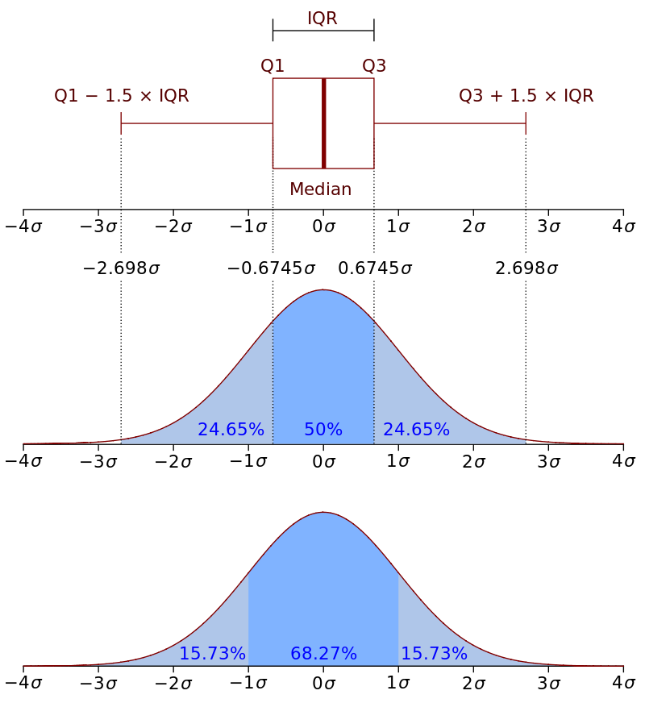
4.4. Data Manipulation
Trieu:
Get numerical features: 14 features
Remove several outliers using Interquartile Range technique
Calculate Q1 (0.25), Q3 (0.75)
Calculate IQR = Q3 - Q1
Calculate upper_bound = Q3 + 1.5 * IQR, lower_bound = Q1 - 1.5 * IQR
Remove observations that have values outside of this range (outliers)

Slide 12
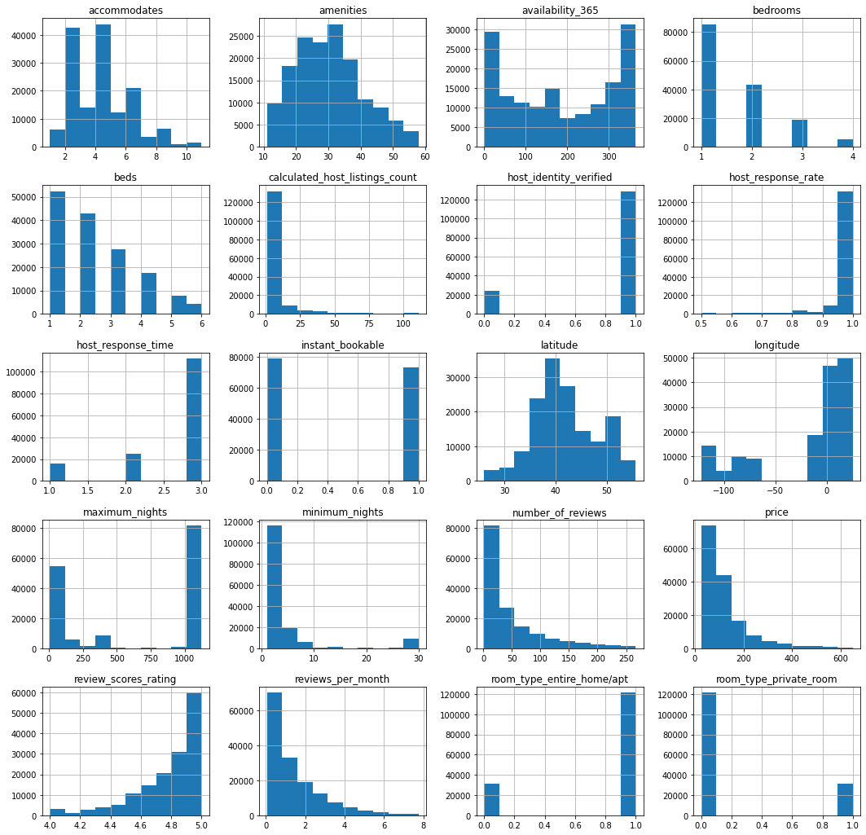
4.5. Data Visualization
Trieu:
Draw the histogram of each feature
Assess the normality of each feature

Slide 13
4.6. Data Reduction
Trieu:
Remove features with high cardinality (host_id, id)
Remove unused features (host_has_profile_pic, host_name, room_type_hotel_room, room_type_shared_room, last_review, neighbourhood, property_type): subset(), select()

Slide 14

5. Models Building & Evaluation
Linear Regression
Trieu
Decision Tree
Create 3 models to predict the price of listings
Random Forest

Slide 15
5.0. Split the dataset
Trieu:
Create the training set : test set with the ratio 7:3 without replacement: sample()
19 predictor variables, 1 target variable (price).
The training set has 106,731 observations, the test set has 45,742 observations.
Clear redundant variables in memory to avoid memory overflow

Slide 16
5.0. Split the dataset
Trieu: 19 predictor variables
accommodates + amenities + availability_365 + bedrooms + beds + calculated_host_listings_count + host_identity_verified + host_response_rate + host_response_time + instant_bookable + latitude + longitude + maximum_nights + minimum_nights + number_of_reviews + review_scores_rating + reviews_per_month + room_type_entire_home_apt + room_type_private_room

Slide 17
5.0. Standardize the dataset
Trieu:
Use Z-score standardization: it is a procedure to “standardize” data to have mean = 0 and standard deviation = 1.
Handle outliers very well
scale()

Slide 18
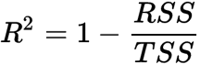
5.0. R^2 Score
R-Squared is the ratio of Sum of Squares Regression (SSR) and Sum of Squares Total (SST). Sum of Squares Regression is amount of variance explained by the regression line. R-squared value is used to measure the goodness of fit. Greater the value of R-Squared, better is the regression model.
The R-Squared is bounded between 0 and 1. If the value of R-Squared is 1, the model fits the data perfectly with a corresponding MSE = 0.

Slide 19
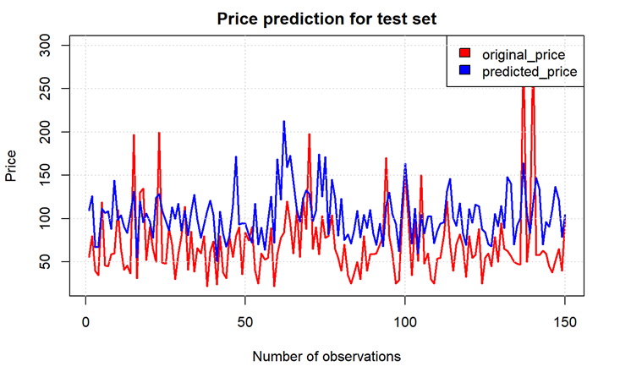
5.1. Linear Regression
Trieu:
Build a GLM based multiple linear regression model: glm.nb()
Use default hyperparameters
Performance Measurement:
On the training set: R^2 Score = 0.22
On the test set: R^2 Score = 0.23
MSE: 5751.281
MAE: 47.05928
RMSE: 75.8372

Slide 20
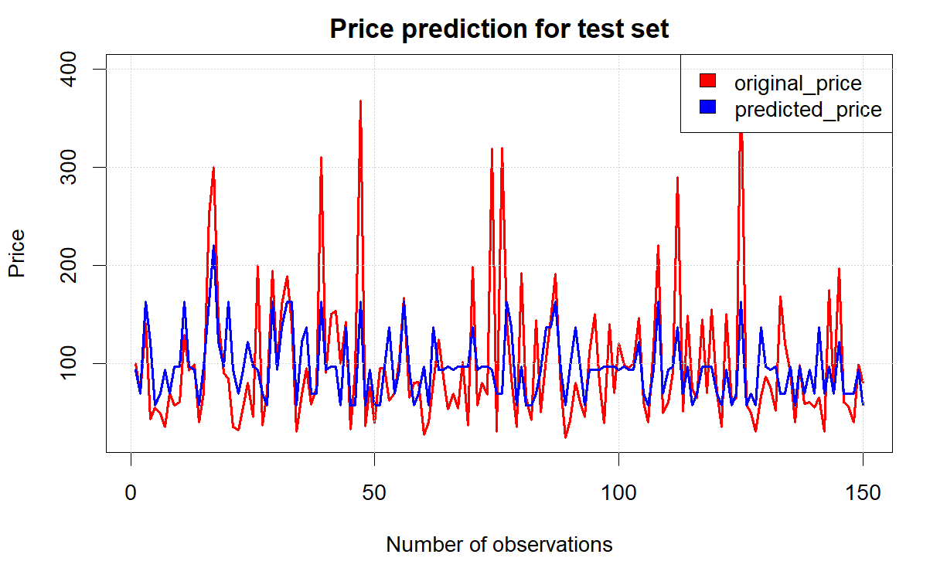
5.2. Decision Tree
Trieu:
Build a Decision Tree Regressor: rpart()
Set method = "anova"
Performance Measurement:
On the training set: R^2 Score = 0.30
On the test set: R^2 Score = 0.30
MSE: 5231.516
MAE: 46.88815
RMSE: 72.32922

Slide 21
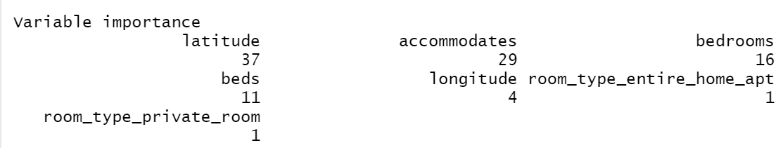
5.2. Decision Tree

Slide 22
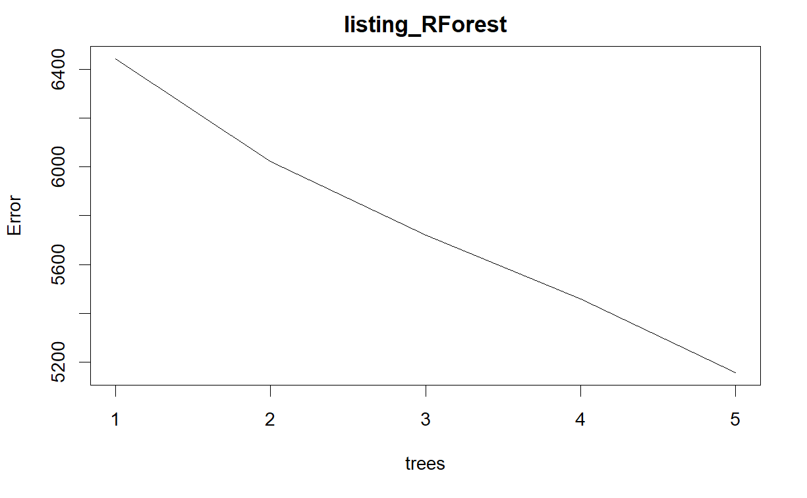
5.3. Random Forest
Trieu:
Build a Random Forest Regressor: randomForest()
Set ntree = 5, importance = TRUE
Performance Measurement:
On the training set: R^2 Score = 0.86
On the test set: R^2 Score = 0.51
MSE: 3698.803
MAE: 37.96295
RMSE: 60.81778

Slide 23
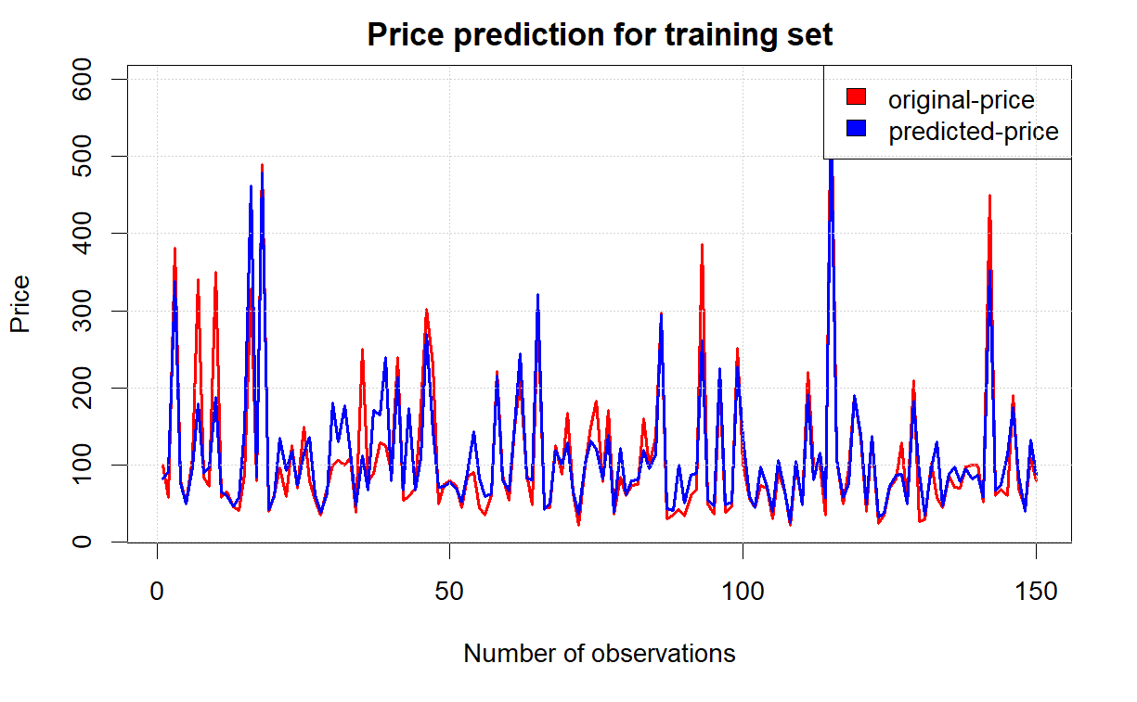
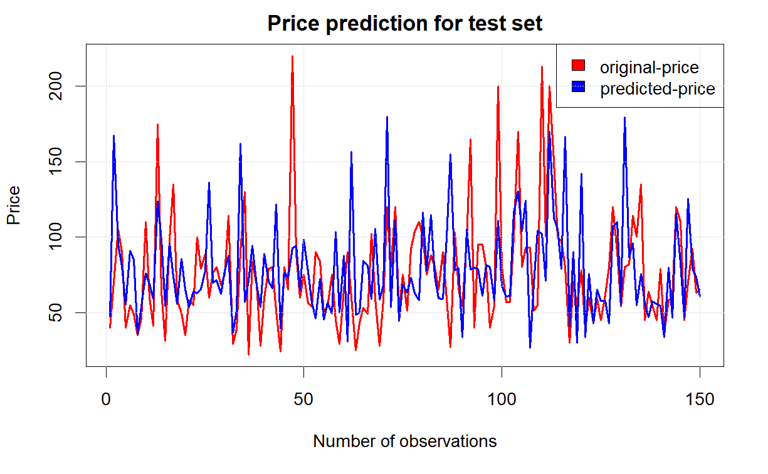
5.3. Random Forest

Slide 24
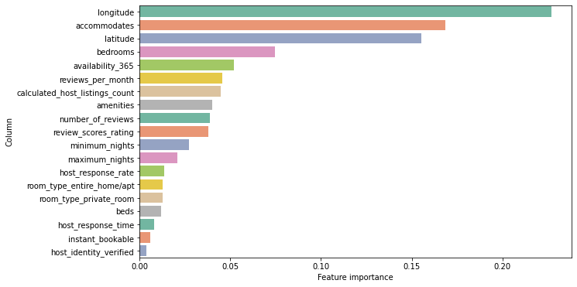
5.3. Random Forest

Slide 25
ALOK SHRIVASTAVA

Slide 26
4.2. Data Import
Alok:
Import necessary libraries
dataPreparation, cowplot, gsubfn, zoo, skimr, effects, sampling, caret, MASS, stringr, fastdummies, class, rpart, C50, tidyverse, dplyr, ggplot2
Import CSV files
For this I used read.csv() function to import the dataset
View the data
For this I used: summary(), head(), str(), dim() function

Slide 27
4.3. Data Cleaning
Alok:
Cleaning column names: it useful for skim() function
Finding missing values: I used this function to find the number of missing values present
Conversion of blank spaces with N/A: For this I used “listing_final [listing_final == " "] <-NA”
Replacement of N/A with previous values: I used na.locf() function

Slide 28
4.4. Data Manipulation
Alok:
Converting amenities from character to numeric datatype: I used the strsplit() function
Removal of special character: The next step involves the removal of the special character “$”
Creating dummy variables: Conversion of room_type to dummy variables
Replacement of characters with binary integers: In this step I removed “t” and “f” from variables and converted them to binary values i.e., 0 and 1

Slide 29
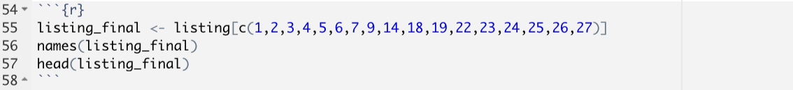
4.5. Data Reduction
Alok:
Removing useless data columns from the dataset: Removed columns like customer name, longitude, latitude, calculated host listing count etc.

Slide 30
5. Models Building & Evaluation
Linear Regression
Alok
Create 2 models to predict the price of listings
Random Forest

Slide 31
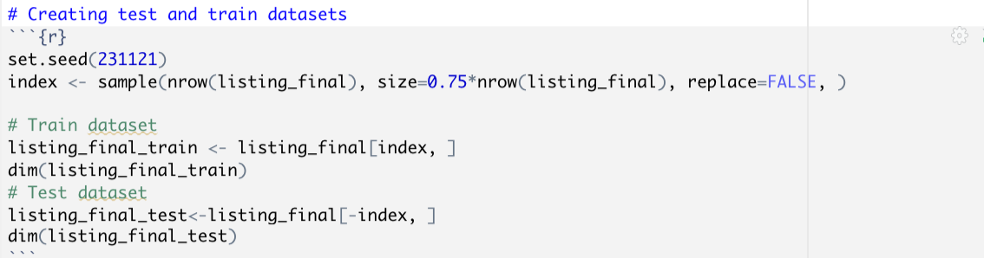
4.6. Data Split
Alok:
Creating test and train dataset: 75% train and 25% test
Train: 157962 records and 17 variables
Test: 52665 records and 17 variables

Slide 32
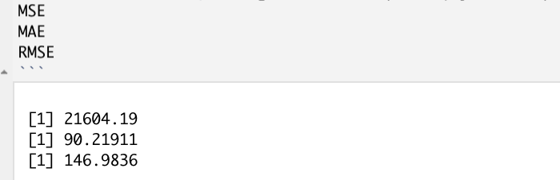
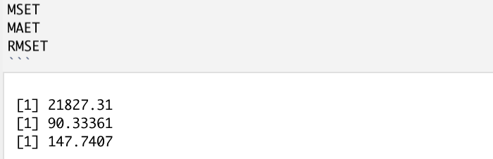
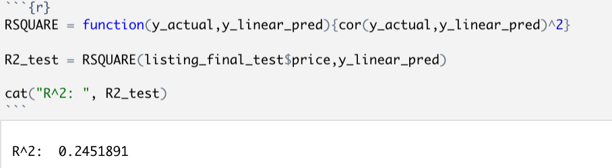
5.1. Linear Regression
MSE, MAE and RMSE values for Train and Test dataset in linear regression model:
R2 value for linear regression model:

Slide 33
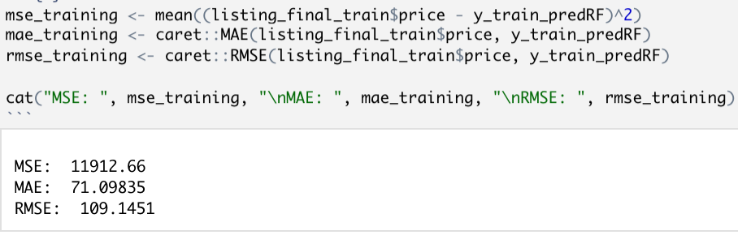
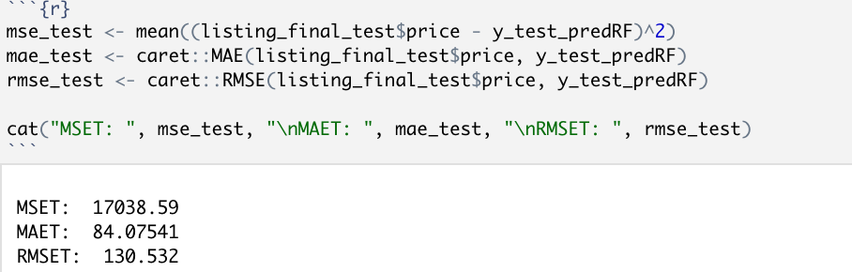
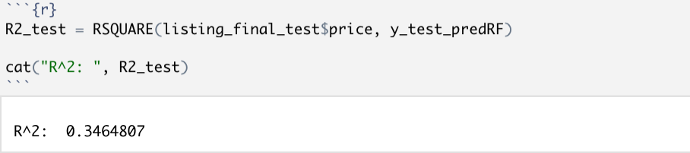
5.2. Random Forest
MSE, MAE and RMSE values for Train and Test dataset in Random Forest model:
2. R2 value for random forest:

Slide 34
6. Conclusion
In this project, we use the Airbnb dataset with 200,000 listings each member and 27 features to explore.
We go through different data science steps to preprocess the data, such as Data Collection, Data Cleaning, Data Manipulation, Data Visualization, and Data Reduction.
We build models to predict the price of listings. They are Linear Regression, Decision Tree, Random Forest. The Linear Regression models of us give similar results (0.24). The Random Forest models give the highest R^2 score on the test set (Trieu: 0.51 vs. Alok: 0.35). The values of MAE and RMSE is also smallest for random forest. Thus we conclude that random forest model is the best fit for the price prediction of airbnb properties. 4 features longitude, latitude, accommodates and bedrooms affect the price most.

Slide 35
THANK YOU FOR LISTENING!

